Slide 1

Mentee : Udit Sharma
Project : Data Analysis

Slide 2
Point system
I’ve given points to every car by comparing the specification with the average specification of particular group.
By using the point system we can determine the different Customer segments.
We can also find the most popular car in the particular segment.
By comparing multiple specification like engine type, fuel type, mileage and other salient features.
After execution of each query the best car is shown on the top of the web application .

Slide 3
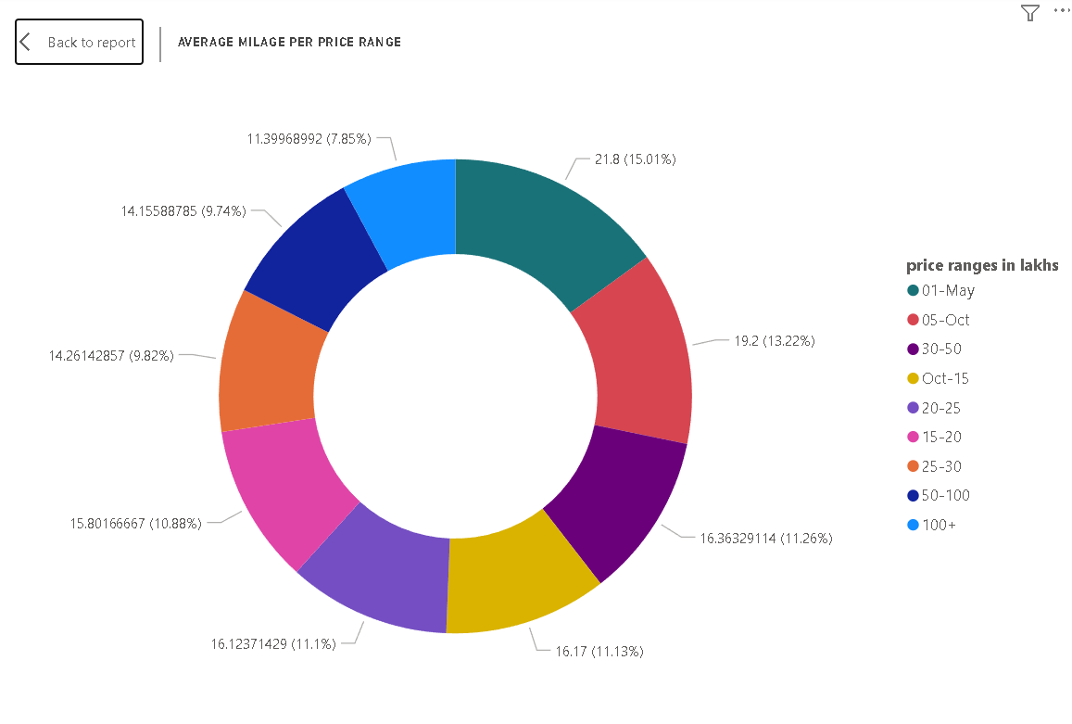
Average Mileage per Price range
In this Donut chart we can see the average mileage of the cars for every price ranges in lakhs
1-5 lakhs accounted for 15.01% of average overall price wise petrol/diesel.

Slide 4
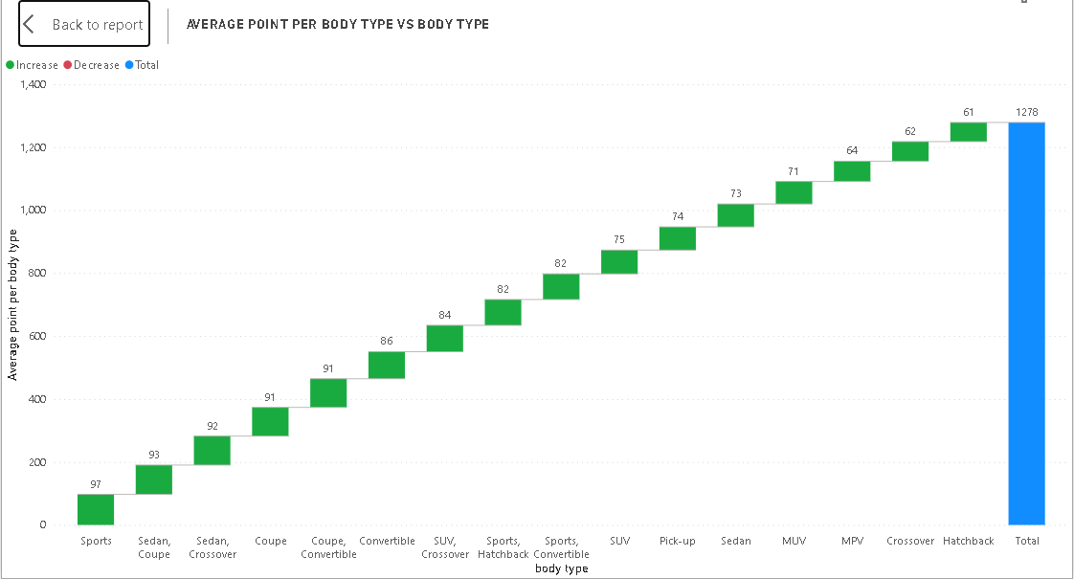
Average point per Body type
In this Waterfall Chart we can see
Average points given to every Body Type of the car
Hatchback with 60.79 points has gained the minimum points
Sports with 97.33 points has gained the maximum points

Slide 5
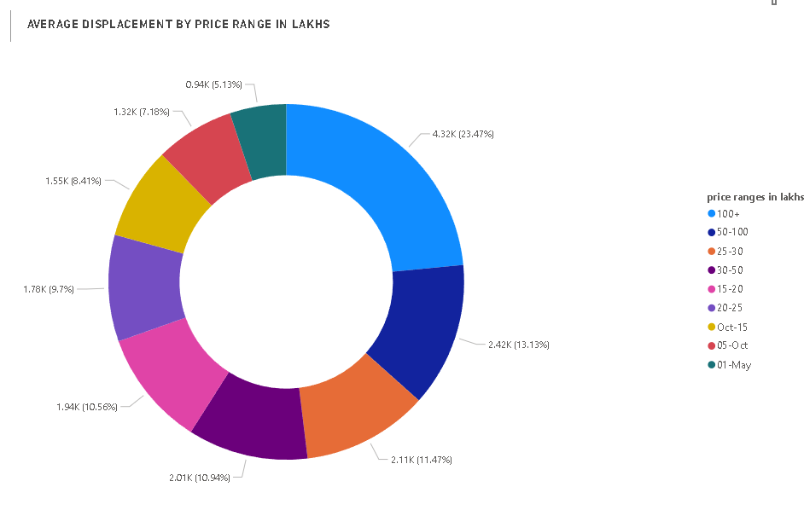
Average Displacement by price ranges
In this we can see the Average displacement of cars by price ranges in lakhs
100+ accounted for 23.47% of average cc pricewise

Slide 6
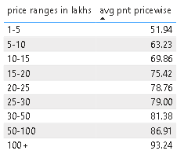
Average Points of cars pricewise
In this we can see the average points of cars by price ranges in lakhs
100+ price range cars has gained the maximum points
1-5 lakhs price range cars has gained the minimum points

Slide 7
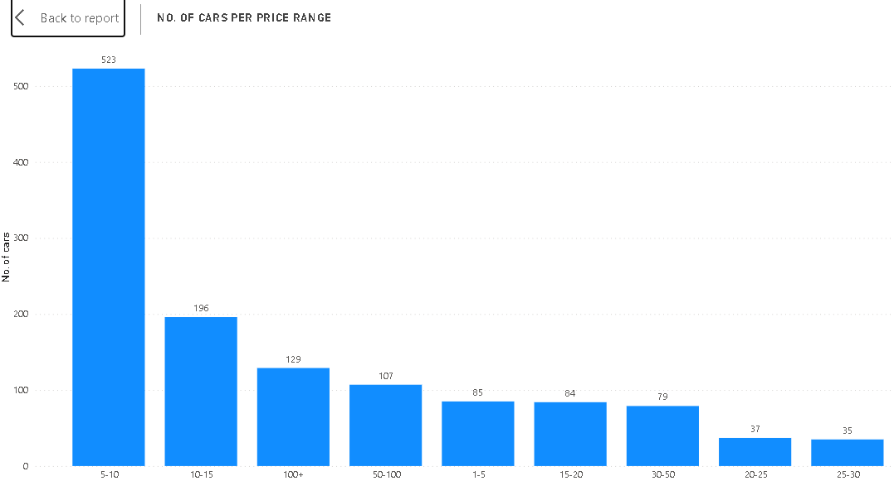
No. of Cars per price range
At 523, 5-10 had the highest price based cars count and was 1,394.29% higher than 25-30 , which had the lowest price based cars count of 35.
5-10 accounted for 41.02% of price based cars count.
Across all 9 price ranges in lakhs , price based cars count ranged from 35 to 523
﻿
﻿﻿
﻿

Slide 8
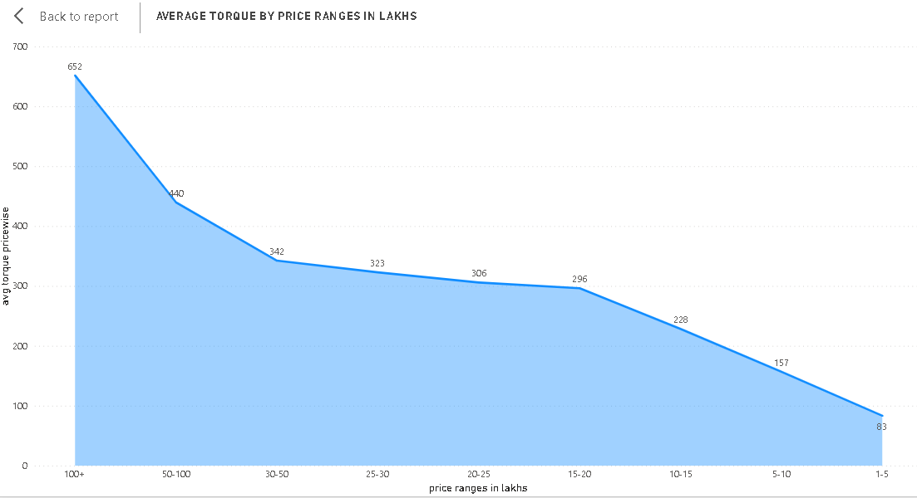
Average Torque by price range
In this area chart we can see the Average torque by price range in lakhs
At 651.67 , 100+ had the highest average torque pricewise and was 682.93% higher than 1-5 , which had the lowest average torque pricewise at 83.24
100+ accounted for 23.05% of average torque pricewise
Across all 9 price ranges in lakhs , average price wise ranged from 83.24 to 651.67

Slide 9
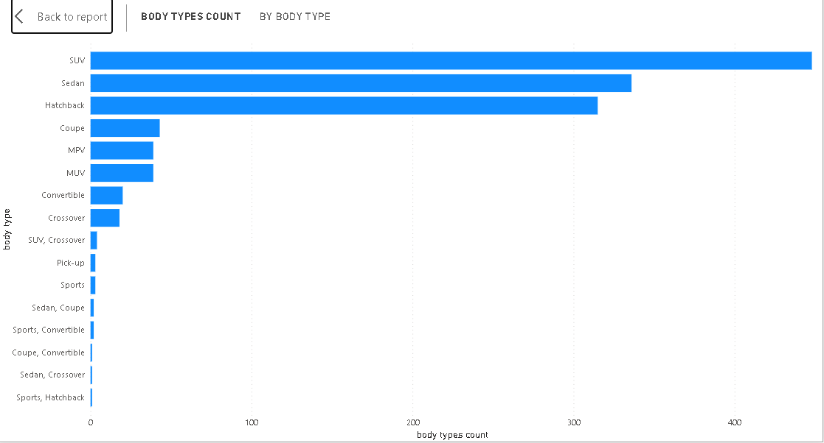
Body type count of per body type
In this line chart we can see the Body type count of per body type
Body type count was highest for SUV at 448 , followed by Sedan and Hatchback
SUV accounted for 35.14% of body type counts
Across 16 body type, the body type count ranged from 1 to 448

Slide 10
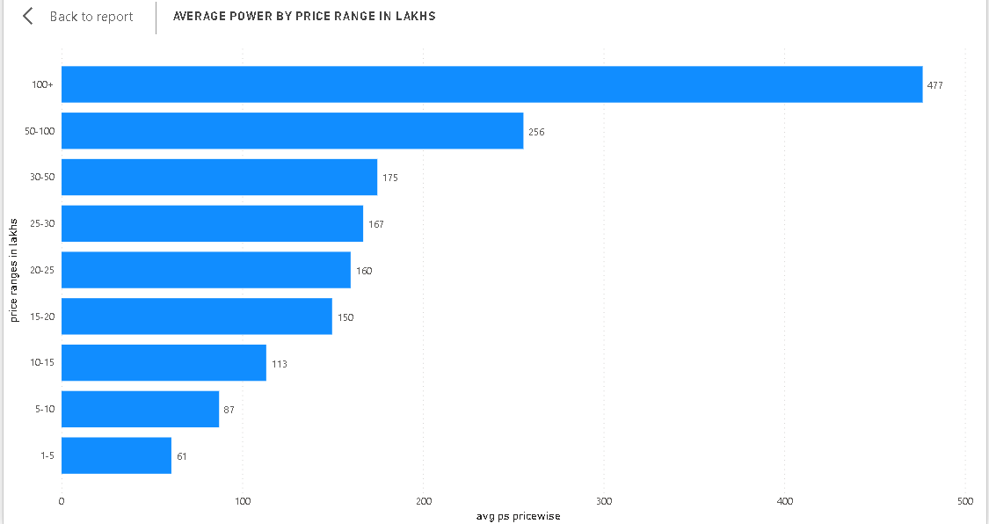
Average Power by price range
In this line chart we can see the average power of cars per price ranges
At 476.60 100+ has the highest average power pricewise and was 684.27% higher than 1-5 range , which had the lowest average power pricewise at 60.77
100+ accounted for 28.98% of average power pricewise
Across all 9 price ranges in lakhs , average power pricewise ranged from 60.77 to 476.60

Slide 11
Thankyou!!

